Slide 1
OUTLINE (our use):
Kim – introduction & project structure
What our idea was and why we wanted to do it
Database structure/design
Ryan – backend design
More on databases, and handlebars, packages we used (anti/curse word input package, etc.)
Risa – Front-end & demo
Describe what she and Kenzie did for front-end design
Demo with audience participation
Mention stretch goals?
Kenzie – want to record anything ahead of time?

Slide 2
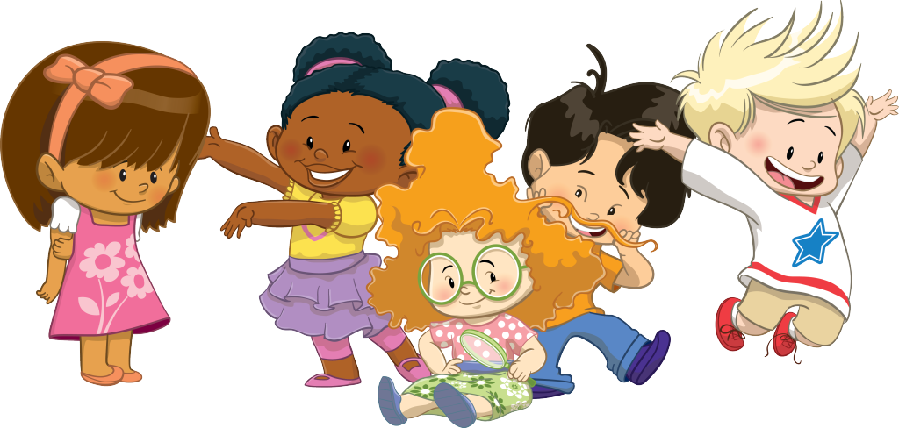
Baby, Build*a*Book!
Brought to you by: R2-K2

Slide 3
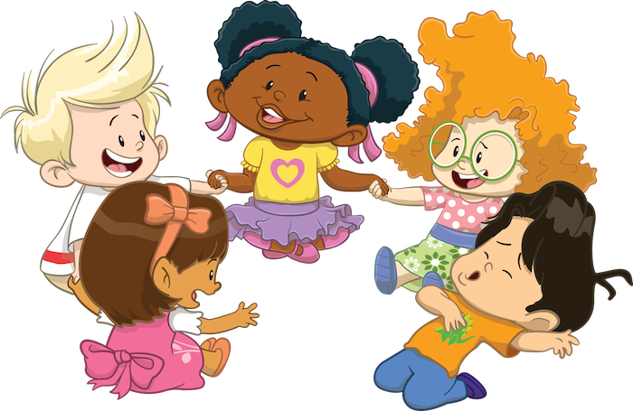
PROJECT Objective
WHY THIS PROJECT?
Select a project that would be geared for a different audience then we have seen in projects thus far
We select a project for younger people
It is a project that is designed to give back
Use at Children Hospital on Story Night
OUR MVP:
Select an Avatar
Select a theme
Input information about the child that is unique to the child
Generate a story book

Slide 4
Database Design
ID | Theme | Title | Page 1 | Page 2 | Page 3 | Page 4 | Page 5 | Page 6
1 | Beach | ___{Char_Name}'s Day at the Beach | It was a bright, sunny summer day when ___{Char_Name} went to visit the beach with their parents and best friend, ____{BFF}. | ___{Char_Name} loved going to the beach and ___{Fav_Activity} in the water and wave at the fish swimming by. Often they would name the fish after ___{Fav_Char} | Today ___{Char_Name} was looking for a very special shell. This shell would allow them to hear the ocean, even when they returned back home to the big city! Can you guess what kind of shell this is? | It is a special shell they were looking for. As it was big and bright and ___{fav_Color}. They looked for it in the water and they looked for it in the sand. | I bet if we had a ___{Fav_Animal} they could help us find the shell | They looked everywhere for the special shell, but sadly they did not find it. While searching though they came across a food cart, that was selling ___{fav_food}, so they enjoyed a snack together.
2 | Space | ___{Char_Name}'s Space Adventure | My name is ___{Char_Name} and I think it would be cool to be in outer space. | I would travel in my ___{Fav_Color} rocket. If I could I would bring ___{fav_animal} to keep me company. | If it gets scary while traveling to space, I will think about ___{Fav_Char} and they will keep my safe. | Inside my rocket, I would have ___{Fav_Food} to eat while I peek out the window and look at the stars. | I would go to the moon and ___{Fav_Activity}. It might be hard because you float like a bubble. | I would wave to my family and I would wave to ___{BFF_Name}. Even though they might not see me.
3 | Forrest | A Forrest Hike with ___{Char_Name} | Once upon a time there was a little bear named ___{Char_Name}. | ___{Char_Name} lived in a little ___{Fav_Color} treehouse surrounded by flowers and streams. They also lived with their favorite animal, ___{fav_Animal} | ___{Char_Name}'s best friend was another little bear named ___{BFF_Name} | During the day, the little bears would often play in the streams, climb trees and play ___{Fav_Activity}. | When ___{Char_Name} and ___{BFF_Name} got hungry they would eat fish, slurp honey and snack on ___{Fav_Food}. | Sometime, when they were out on an adventure they would present to be ___{Fav_Char}. And when their day of adventures was done, they would return to treehouse for well needed nap.
4 | Park | Walk with ___{Char_Name} in the Park | Welcome to Central Park. My name is ___{Char_Name}. I cannot wait to tell you about the park. | My favorite person to walk in the park is ___{BFF_Name}. We walk together almost every day. | The first place we are going to go is to the Central Park Zoo. I hope we see ___{Fav_Animal}. | When we are walking the park, there is lots of food to buy. There's my favorite food, ___{Fav_Food} now! Let's get something to eat! | Next, we are going to ride on the carousel. My favorite character to ride is the ___{Fav_Color} one that goes up and down. ___{Bff_Name} likes the white horses. | When we aren't at the zoo, or riding the carousel, we often play ___{Fav_Activity} or pretending to be ___{Fav_Char}.
Database
Tables
Themes
Two Tables
No Relationship
Pull information from Themes
Perform a replace
Update Story
ID | Theme | Title | Avatar | Page 1 | Page 2 | Page 3 | Page 4 | Page 5 | Page 6
1 | Beach | RISA's Day at the Beach | Risa | It was a bright, sunny summer day when RISA went to visit the beach with their parents and best friend, MIA. | RISA loved going to the beach and SWIMMING in the water and wave at the fish swimming by. Often they would name the fish after Pooh. | Today RISA was looking for a very special shell. This shell would allow them to hear the ocean, even when they returned back home to the big city! Can you guess what kind of shell this is? | It is a special shell they were looking for. As it was big and bright and MAGENTA. They looked for it in the water and they looked for it in the sand. | I bet if we had a OPPOSUM they could help us find the shell | They looked everywhere for the special shell, but sadly they did not find it. While searching though they came across a food cart, that was selling CHOCOLATE, so they enjoyed a snack together.
2 | Space | RYAN's Space Adventure | Ryan | My name is RYAN and I think it would be cool to be in outer space. | I would travel in my GREEN rocket. If I could I would bring a DOG to keep me company. | If it gets scary while traveling to space, I will think about SUPERMAN and they will keep my safe. | Inside my rocket, I would have FILET MIGNON to eat while I peek out the window and look at the stars. | I would go to the moon and VIDEO GAMING. It might be hard because you float like a bubble. | I would wave to my family and I would wave to MIKEY. Even though they might not see me.
3 | Forrest | A Forrest Hike with KENZIE | Kenzie | Once upon a time there was a little bear named KENZIE. | KENZIE lived in a little PURPLE treehouse surrounded by flowers and streams. They also lived with their favorite animal, SNOW LEOPARD. | KENZIE's best friend was another little bear named KATE. | During the day, the little bears would often play in the streams, climb trees and play HIDE AN GO SEEK. | WhenKENZIE and KATE got hungry they would eat fish, slurp honey and snack on ICE CREAM. | Sometime, when they were out on an adventure they would pretend to be ZENA WARRIOR PRINCESS. And when their day of adventures was done, they would return to treehouse for well needed nap.
4 | Park | Walk with KIMBERLY in the Park | Kimberly | Welcome to Central Park. My name is KIMBERLY. I cannot wait to tell you about the park. | My favorite person to walk in the park is JAMES. We walk together almost every day. | The first place we are going to go is to the Central Park Zoo. I hope we see an ELEPHANT. | When we are walking the park, there is lots of food to buy. There's my favorite food, POPCORN now! Let's get something to eat! | Next, we are going to ride on the carousel. My favorite character to ride is the YELLOW one that goes up and down. JAMES likes the white horses. | When we aren't at the zoo, or riding the carousel, we often playSOCCER or pretend to be IRON MAN.
Books
BabyBook_DB

Slide 5
The Process
What worked well:
What didn’t work so well:
Turn.js

Slide 6
Baby, Build*a*Book!
DEMO

Slide 7
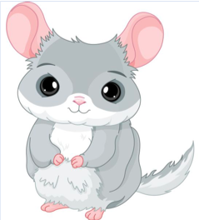
FUTURE GOALS:
Colored text that matches child’s favorite color
Create a user login portal so that users can save books over time
Have an animal image select option, so favorite animal can be placed in story
Ability to print book to PDF
Email link to designed book to share with others
Add contribute story content for more stories
Share artwork

